Slide 1
Unit 2 Review
Integrity
Availability
Information Security
Confidentiality

Slide 2
Quantitative Analysis
A quantitative impact analysis assigns a dollar value to the impact

Slide 3
Qualitative Analysis
A qualitative impact analysis assesses impact in relative terms such as high impact, medium impact, and low impact without assigning a dollar value to the impact

Slide 4
Quantitative vs. Qualitative
Quantitative
Focuses on factual and measurable data
Qualitative
Focuses on perceptions about the probability of a risk occurring

Slide 5
10. What is the main advantage of using a quantitative impact analysis over a qualitative impact analysis?
A qualitative impact analysis identifies areas that require immediate improvement
A qualitative impact analysis provides a rationale for determining the effect of security controls
A quantitative impact analysis makes a cost benefit analysis simple
A quantitative impact analysis provides specific measurements of attack impacts
Answer: A

Slide 6
14. A business asset is best described by which of the following?
An asset loss that could cause a financial or operational impact to the organization
Controls put in place that reduce the efforts of threats
Competitive advantage, capability, credibility, or goodwill
Personnel, compensation, and retirement programs
Answer: C

Slide 7
Which option most accurately reflects the goals of risk migration?
Determining the effects of a denial of service and preparing the company’s response
The removal of all exposure and threats to the organization
Defining the acceptable level of risk and assigning the responsibility of loss or disruption to a third-party, such as an insurance carrier
Defining the acceptable level of risk the organization can tolerate and reducing risk to that level
Answer: D

Slide 8
Risk Registers

Slide 9
Access controls
Authentication
Authorization
Accounting

Slide 10
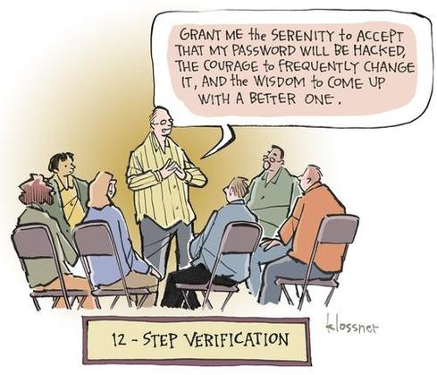

Slide 11

Identity (Who Is the Subject?)
Asserts a unique user or process identity
Typically in the form of an assigned user name
Could be public information whether intentional or not

Slide 12
Registration of New Users
Manual user registration:
Greatest granularity
Too high of an administrative burden
Automated provisioning solutions:
Provide a framework for managing access control policies

Slide 13
Periodic Review of Access Levels
The periodic review of user access levels is incorporated into regulations, including Sarbanes–Oxley

Slide 14
Clearance
Critical where access controls are based on security labels
Trusted user directory
Certificates

Slide 15
Authentication (Proof of Identity)
Verification that the identity presented belongs to the party that has presented it.
Something you know
Something you have
Something you are

Slide 16
Password Reset
Consume a large volume of time in most IT support departments
Provide an effective entry vector for social engineering attacks

Slide 17
Password Reset Made Easy
https://www.darkreading.com/endpoint/self-service-password-reset-and-social-engineering-a-match-made-in-hell/a/d-id/1325891
https://specopssoft.com/blog/social-engineering-warning-watch-out-for-that-password-reset-call/
https://www.csoonline.com/article/3203386/security/even-weak-hackers-can-pull-off-a-password-reset-mitm-attack-via-account-registration.html

Slide 18
Mass Lockouts
Effective denial-of-service attack
Example: eBay Account Lockout Attack

Slide 19
Ownership
Something the user has in their possession
Smart cards: Contact, contactless
Dynamic passwords
Tokens: Synchronous, asynchronous
Radio Frequency Identification (RFID)

Slide 20

Characteristic
A physical trait of the user
Allows for the confirmation of an individual’s identity

Slide 21
Biometrics
Two steps:
Enrollment process
Verification process
Two main classifications:
Behavioral
Physiological

Slide 22
Behavioral Biometrics
Signature analysis
Voice pattern recognition
Keystroke dynamics

Slide 23
Physiological Biometrics
Fingerprint verification technology
Hand geometry technology
Eye features/retina scan
Eye features/iris scan
Facial recognition

Slide 24
Biometric Accuracy
False Rejection Rate (FRR)
False Acceptance Rate (FAR)

Slide 25
Physical Use as Identification
Biometrics takes advantage of the unique physical traits of each user
Arguably is the most effective methodology of identifying a user

Slide 26
Tokens
Proves identity electronically
Used in addition to or in place of a password

Slide 27
Smart Card Applications
Secure identity applications
Healthcare applications
Payment applications
Telecommunications applications

Slide 28
Multifactor Authentication
Implement at least two of the three common techniques for authentication
Knowledge based
Token based
Characteristic based

Slide 29
Two-Factor vs. Three-Factor Authentication
In two-factor authentication, typically the mechanism provides for:
Something the user has
Something the user knows
This can be significantly improved upon by incorporating a third factor

Slide 30
https://www.youtube.com/watch?v=0dFAyT4K0a4

Slide 31
Dual Control
No one person should have access to information that would allow the person to determine the encryption key quickly than a brute force attack

Slide 32
Time Outs
If the user leaves the proximity of the device authenticated after a specific time period, he or she is automatically logged off and the authentication process starts over

Slide 33
Reverse Authentication
Today, it is necessary to authenticate the website/page to the user as part of the authentication process

Slide 34
Certificate-Based Authentication
Relies on the machine that the user authenticates having a digital certificate installed that is used along with the encrypted user’s password to authenticate the user and device

Slide 35
Authorization
A reference monitor typically grants access based on an ACL within the reference monitor
Once access is granted, what the subject can then do is controlled by the authorization matrix or table

Slide 36
Access to Systems vs. Data, Networks
Defining ACLs that only address access to systems can facilitate unintended user access
Including access controls to specific data within a given system increases overall security

Slide 37
Access Control Lists/Matrix
Authorization table
A matrix of access control objects, access control subjects, and their respective rights
Access control matrix
Provide simple user interface to implement an ACL
Determines the access

Slide 38
Directories
Lightweight Directory Access Protocol (LDAP)
X.500
Microsoft Active Directory Directory Service

Slide 39
Single Sign-On (SSO)
An authentication mechanism that allows a single identity to be shared across multiple applications
Allows the user to authenticate once and gain access to multiple resources
The primary purpose of SSO is for the convenience of the user

Slide 40
SSO Implementation: Kerberos
Designed to provide strong authentication using secret-key cryptography
An operational implementation of key distribution technology

Slide 41
Kerberos Process
Request a ticket to the Kerberos TGS from the Kerberos AS
AS looks up the access control subject and generates a session key
Access control subject decrypts the first message and recovers the session key
Access control subject sends a request to the TGS for a ticket to a particular target server

Slide 42
Kerberos Process
TGS decrypts the TGT and uses the session key to decrypt the authenticator
TGS creates a new session key
Access control subject decrypts the message and extracts the session key
Target access control object server decrypts and checks the ticket and the authenticator
Server sends the access control subject a message

Slide 43
Kerberos Considerations
Overall security depends on careful implementation
Requires trusted and synchronized clocks across the enterprise network
Enforce limited lifetimes for authentication based on time stamps
The Key Distribution Server must be physically secured
Isolate the Key Distribution Server on the network
The AS can be a critical single point of failure

Slide 44
Comparing Internetwork Architectures
Internet
Intranet
Extranet
Demilitarized Zone (DMZ)

Slide 45
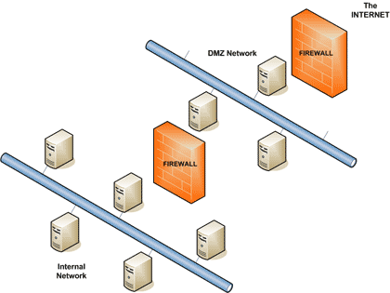
Typical DMZ Design

Slide 46
One-Way Trust
A unidirectional authentication path that is created between two domains
Some one-way trusts can be either a non-transitive trust or a transitive trust

Slide 47
Two-Way Trust
In a two-way trust, Domain A trusts Domain B, and Domain B trusts Domain A
Authentication requests can be passed between the two domains in both directions
Some two-way relationships can be either non-transitive or transitive

Slide 48
Transitive Trust
Transitivity determines whether a trust can be extended outside the two domains between which the trust was formed
You can use a transitive trust to extend trust relationships with other domains
You can use a non-transitive trust to deny trust relationships with other domains

Slide 49
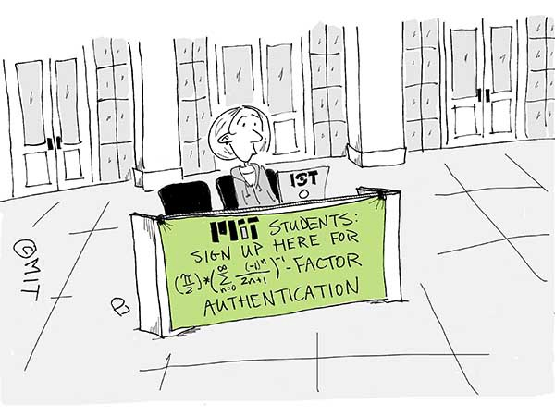

Slide 50
Identity Management
Identity management is the task of controlling information about users on computers
Goal:
Improve company-wide productivity and security, while lowering the costs associated with managing users

Slide 51
Identity Management Life Cycle
Authorization
Proofing
Provisioning
Maintenance
Entitlement

Slide 52
Authorization
Determines whether a user is permitted to access a particular resource
Performed by checking the resource access request against authorization policies that are stored in an Identity Access Management (IAM) policy store

Slide 53
Provisioning
Creation of the identifier for the identity
Linkage to the authentication providers
Setting and changing attributes and privileges
Decommissioning of the identity

Slide 54
Maintenance
User management
Delegated administration
Self-password reset

Slide 55
Entities
People
Devices
Organizations
Code
Agents

Slide 56
Entitlement Defined
A set of rules, defined by the resource owner, for managing access to a resource and for what purpose

Slide 57
Mandatory Access Control (MAC)
Eliminates problems of relying on each system owner to properly control access to each object
The system participates in applying a mandatory access policy
The system owner applies the “need to know” element

Slide 58
Non-Discretionary Access Control
Non-discretionary policies establish controls that cannot be changed by users but only through administrative action

Slide 59
Discretionary Access Control (DAC)
A DAC policy is a means of assigning access rights based on rules specified by the owner

Slide 60
Rule Set-Based Access Controls (RSBAC)
Discretionary controls giving data owners the discretion to determine the rules necessary to facilitate access
Many security policies can be implemented as a decision module

Slide 61
Role-Based Access Control (RBAC)
Users are granted membership into roles based on their competencies and responsibilities
The operations that a user is permitted to perform are based on the user's role
Simplifies the administration and management of privileges

Slide 62
Role Hierarchies
Natural way of organizing roles to reflect authority, responsibility, and competency
The role in which the user is gaining membership is not mutually exclusive with another role for which the user already possesses membership

Slide 63
Constrained User Interface (CUI)
Methodology that restricts the user’s actions to specific functions by not allowing the user to request functions that are outside of his/her respective level of privilege or role

Slide 64
Types of Restricted Interfaces
Menu and Shells
Database views
Physically constraining a user interface

Slide 65
View-Based Access Control (VBAC)
Separates a given access control object into subcomponents and permits or denies access to view or interact with specific subcomponents

Slide 66
Content-Dependent Access Control (CDAC)
Protects databases containing sensitive information
Permits or denies access based on the explicit content within the object
Requires a great deal of labor in defining the respective permissions

Slide 67
Context-Based Access Control (CBAC)
Used in firewall applications to extend the firewall’s decision-making process to:
Decisions based on state
Application-layer protocol session information

Slide 68
Temporal Isolation (Time-Based)
Used to enhance or extend the capabilities of RBAC implementations
Supports periodic role enabling and disabling and temporal dependencies

Slide 69
Attribute-Based Access Control (ABAC)
Subject requests to perform operations on objects are granted or denied based on:
Assigned attributes of the subject
Assigned attributes of the object
Environment conditions
A set of policies

Slide 70
